Slide 1
Unit 201: Health and safety in building services engineering
Risk assessment

Slide 2
Risk assessments
In order to control the risk of an accident, we usually:
eliminate the cause
substitute a procedure or product with less risk
enclose the dangerous situation
put guards around the hazard
use safe systems of work
supervise, train and give information to staff
provide PPE – if the hazard cannot be removed or minimised.

Slide 3
Risk assessments
A hazard is something with the ‘potential’ to cause harm; for example, chemicals, electricity or working above ground.
A risk is the ‘likelihood’ of harm actually being done.
Typical activity
Receiving materials
Stacking and storing
Movement of people
Building maintenance
Movement of vehicles
Potential hazard
Lifting and carrying
Falling materials
Slips, trips and falls
Working at heights or in confined spaces
Collisions

Slide 4
Risk assessments – the process
Step 1 – Identify the hazards.
Step 2 – Decide who might be harmed and how.
Step 3 – Evaluate the risks and decide on precautions.
Step 4 – Record your findings and implement them.
Step 5 – Review your risk assessment and update if necessary.

Slide 5
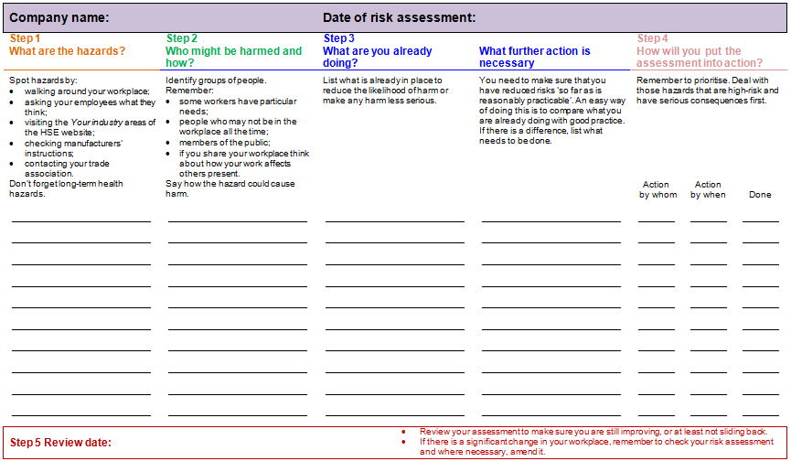
Risk assessments – sample form

Slide 6
Unit 201: Health and safety in building services engineering
The End

